Slide 1
Fine-grained Recognition(细粒度分类)
沈志强

Slide 2
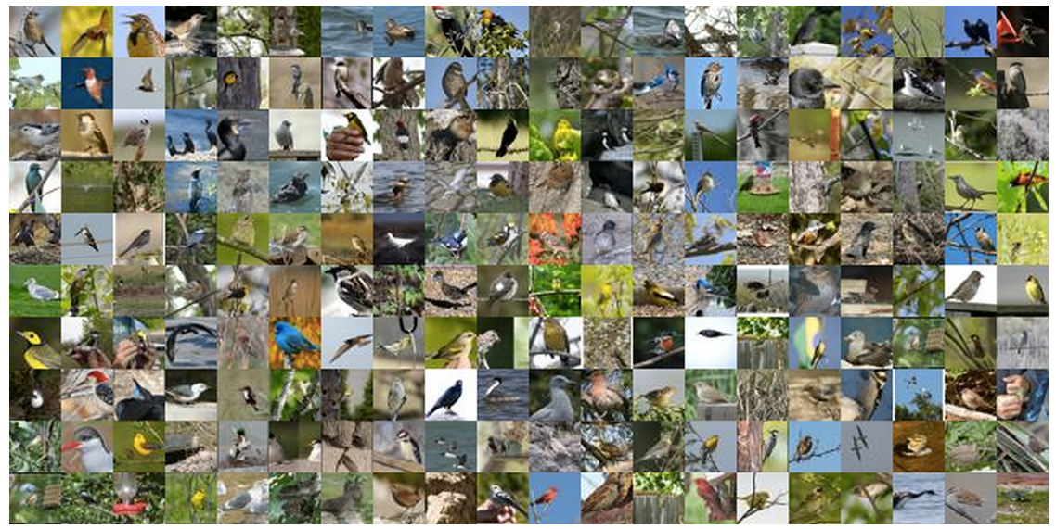
Datasets -- Caltech-UCSD Bird-200-2011
Number of categories: 200
Number of images: 11,788
Annotations per image: 15 Part Locations, 1 Bounding Box

Slide 3
Methods
feature extraction + classification
global feature extraction + part feature representations

Slide 4
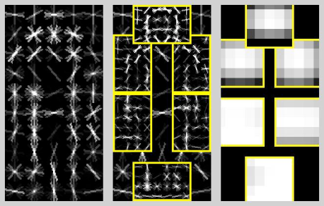
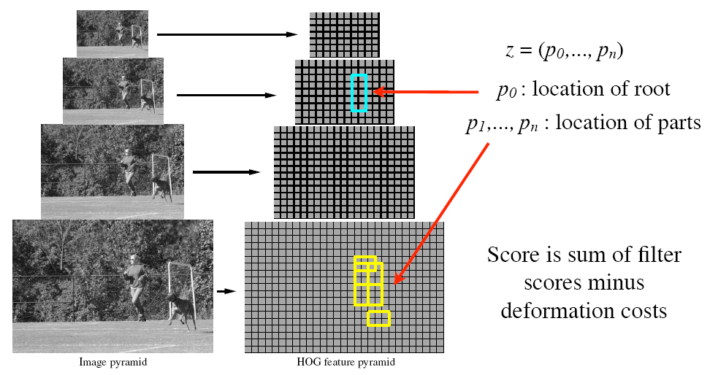
Object hypothesis^{[1]}
Multiscale model: the resolution of part filters is twice the resolution of the root

Slide 5
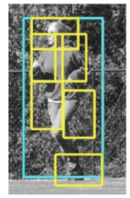
Scoring an object hypothesis
The score of a hypothesis is the sum of filter scores minus the sum of deformation costs
Subwindow features
Displacements
Filters
Deformation weights

Slide 6
Scoring an object hypothesis
The score of a hypothesis is the sum of filter scores minus the sum of deformation costs
Subwindow features
Displacements
Filters
Deformation weights
Concatenation of filter and deformation weights
Concatenation of subwindow features and displacements

Slide 7
Training
Our classifier has the form
w are model parameters, z are latent hypotheses
Latent SVM training:
Initialize w and iterate:
Fix w and find the best z for each training example (detection)
Fix z and solve for w (standard SVM training)
Issue: too many negative examples
Do “data mining” to find “hard” negatives

Slide 8
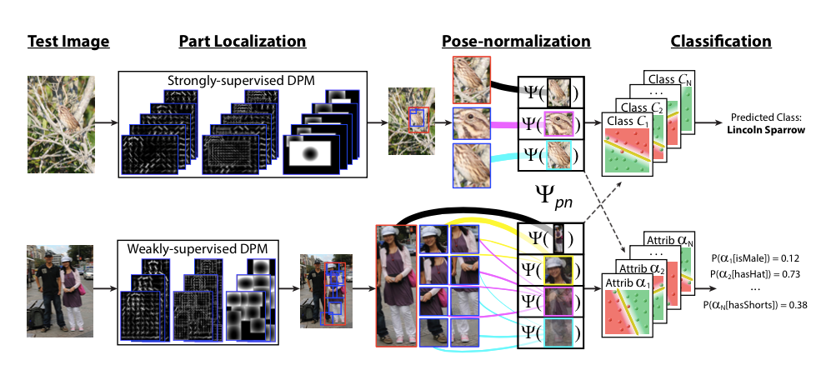
Deformable Part Descriptors (DPDs) - ICCV2013^{[4]}
Strongly-supervised DPD
Weakly-supervised DPD

Slide 9
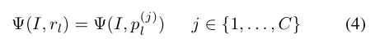
Pose-normalization
Strongly-supervised DPD
is the pooled image feature for semantic region r_{l}
figure out a mapping S^{(j)} :

Slide 10
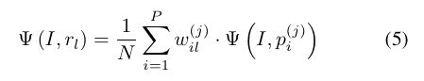
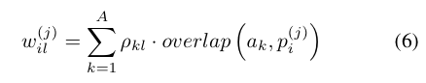
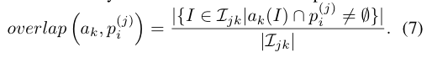
Pose-normalization
Weakly-supervised DPD

Slide 11
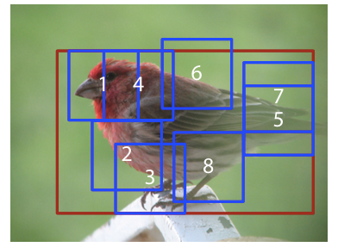
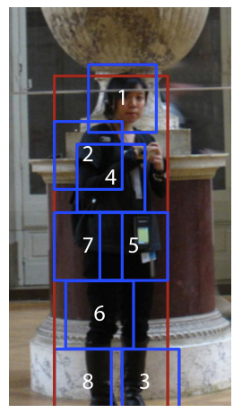
Detection results

Slide 12
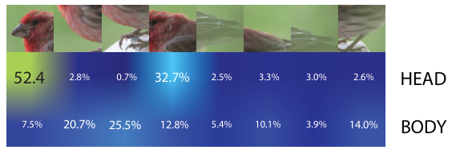
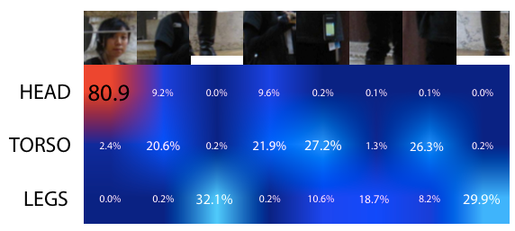

Slide 13
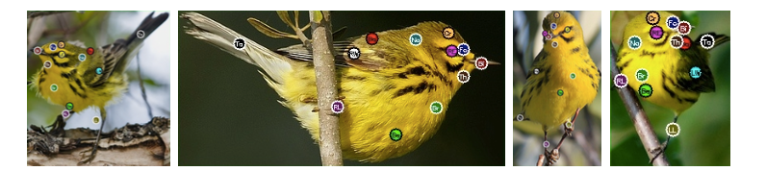
Nonparametric Part Transfer for Fine-grained Recognition(CVPR 2014) ^{[3]}

Slide 14
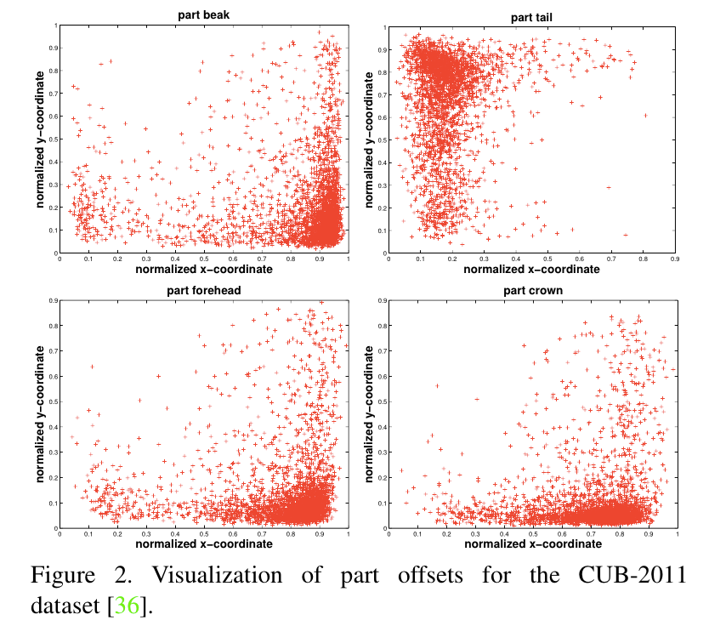
Nonparametric Part Transfer for Fine-grained Recognition(CVPR 2014)

Slide 15
Nonparametric Part Transfer for Fine-grained Recognition(CVPR 2014)
The distribution is clearly non-Gaussian, therefore, a single DPM model would not be able to model the variation present in the training dataset.

Slide 16
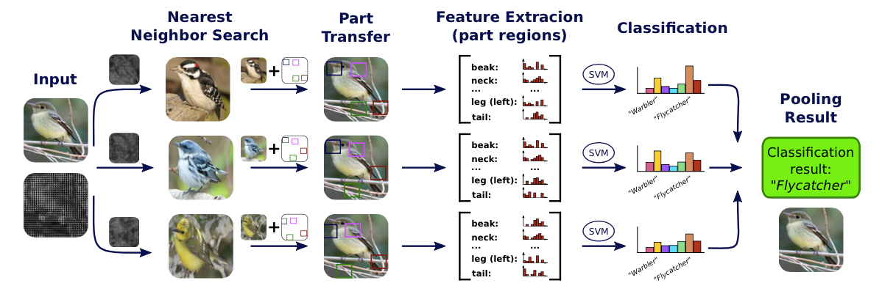
Nonparametric Part Transfer for Fine-grained Recognition(CVPR 2014)

Slide 17
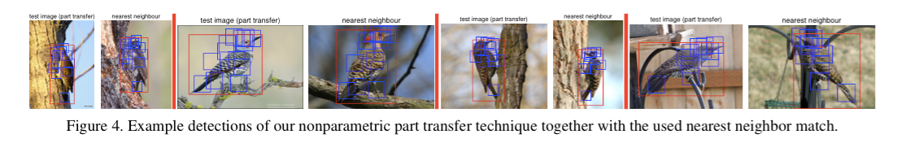
Example detections

Slide 18
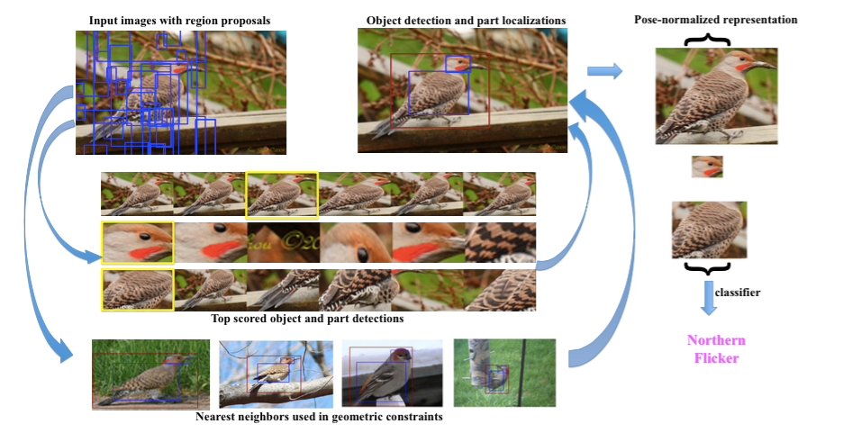
Part-based R-CNNs for Fine-grained Category Detection(ECCV 2014 oral) ^{[2]}

Slide 19
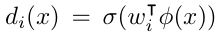
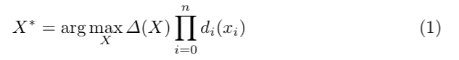
Part-based R-CNNs for Fine-grained Category Detection(ECCV 2014 oral)
Geometric constraints
Let X = {x₀ , x₁ ,..., x_{n}} denote the locations (bounding boxes) of object p0 and n parts {p_{i}}.
where σ(·) is the sigmoid function and φ(x) is the CNN feature descriptor extracted at location x.
where ∆(X) defines a scoring function over the joint configuration of the object and root bounding box.

Slide 20
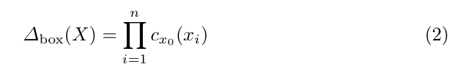
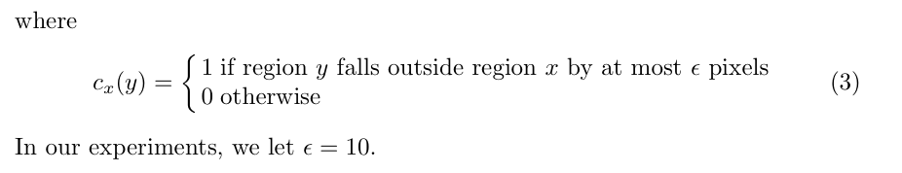
Part-based R-CNNs for Fine-grained Category Detection(ECCV 2014 oral)
Box constraints

Slide 21
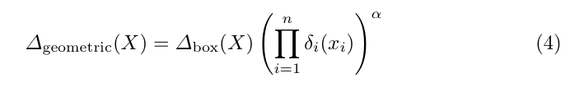
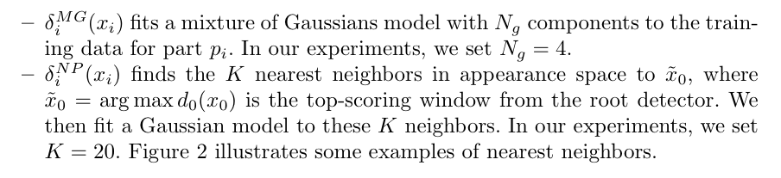
Part-based R-CNNs for Fine-grained Category Detection(ECCV 2014 oral)
Geometric constraints
where δ_{i} is a scoring function for the position of the part p_{i} given the training data.

Slide 22
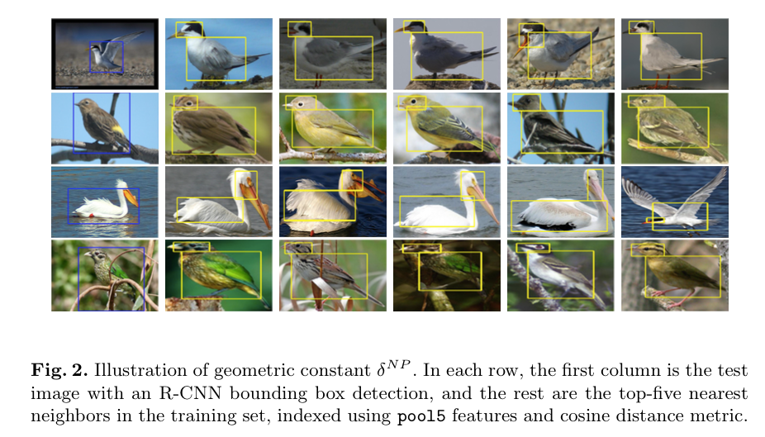
Illustration of geometric constant

Slide 23
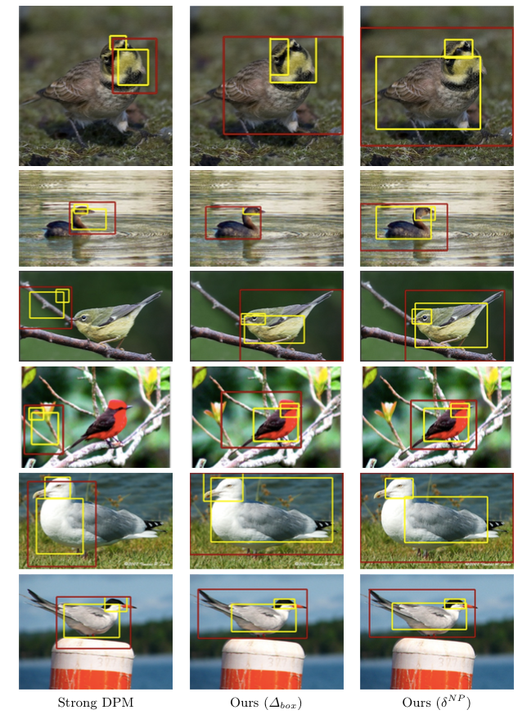

Slide 24
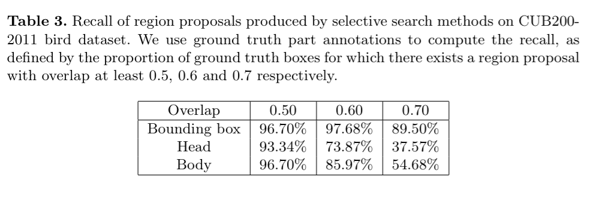
Recall

Slide 25
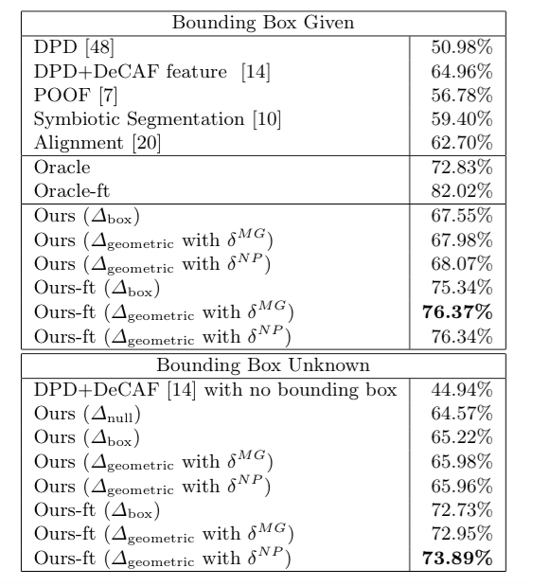
Results

Slide 26
Conclusion
feature extraction + classification
global feature extraction and part feature representations
Part localization is a crucial step .

Slide 27
References
[1] Felzenszwalb, P.F., Girshick, R.B., McAllester, D., Ramanan, D. Object detection with discriminatively trained part based models. IEEE Transactions on Pattern Analysis and Machine Intelligence (2010)
[2] Ning Zhang, Jeff Donahue, Ross Girshick, Trevor Darrell.Part-based R-CNNs for Fine-grained Category Detection. ECCV 2014.
[3] Christoph Goring, Erik Rodner, Alexander Freytag, and Joachim Denzler∗. Nonparametric Part Transfer for Fine-grained Recognition. CVPR 2014
[4] N. Zhang, R. Farrell, F. Iandola, and T. Darrell. Deformable part descriptors for fine-grained recognition and attribute prediction. In ICCV, 2013.

Slide 28
Thanks & Questions

